Slide 1
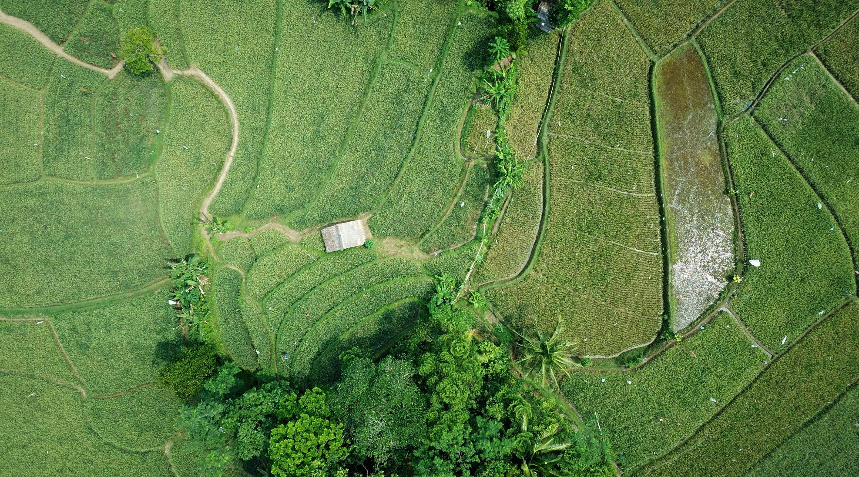
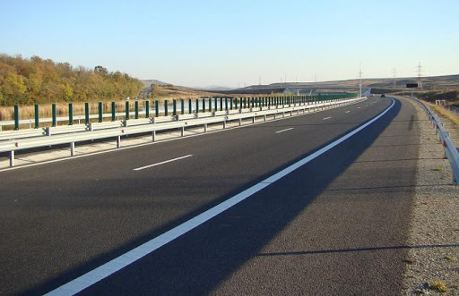
Eco-innovation and its effects on the environment
Alexandru Ioan Cuza University of Iasi, Romania
Faculty of Economics and Business Administration
Assoc. Prof., PhD. Hab. Ana-Maria Bercu
Master students:Adriana Bejinariu, Ana-Maria Popescu
Public Administrațoin, 2nd year of stydy
IAȘI 2020

Slide 2
Content
Introduction
Strategic vision
  Idea no. 1. Separation and use of carbon dioxide
  Idea no. 2. The electric bus without compromises
  Idea no. 3. Use oil instead of wood, in the kitchen
  Idea no. 4. Drinking water from polluted water
Conclusion

Slide 3
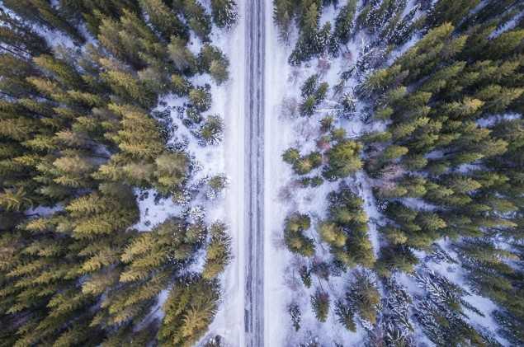
Introduction
important to know the effects we leave behind through our actions and to be aware of the effects that will occur.
ecological consciousness is a complex mental education, which includes cognitive, regulatory, emotional, ethical, and other aspects
to maintain a balance between the nature and the people, a strategic development planning is required.

Slide 4
Strategic vision
strategic vision must be realized and implemented according to the aspirations presented by the European Union.
environmental strategies must be aligned with the development strategies, supporting each other.
the city of the future must be an intelligent one, SMART City, based on development among the active sectors that are environmentally friendly.

Slide 5
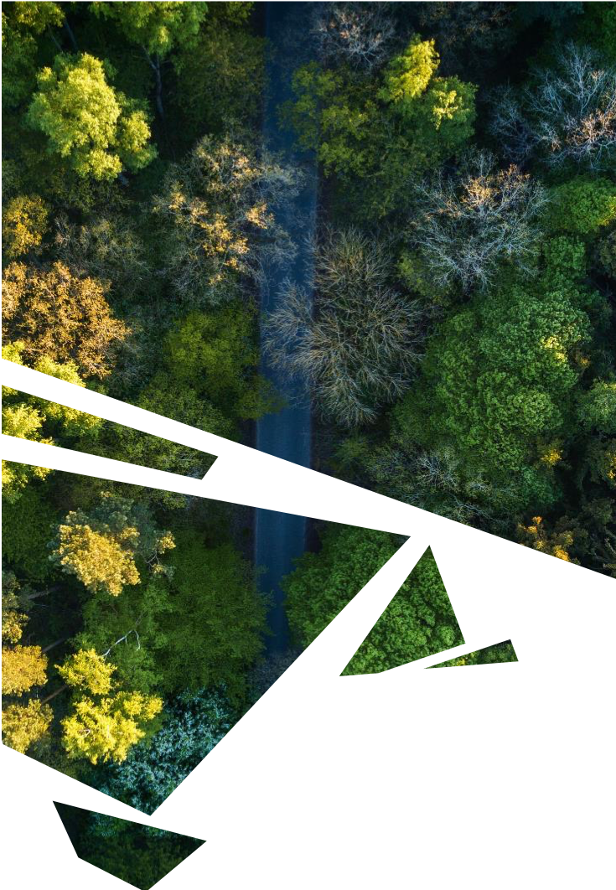
  Idea no. 1. Separation and use of carbon dioxide
the global increase in the concentration of carbon dioxide in the atmosphere cannot be stopped.
reusing carbon dioxide as a raw material is much more cost effective than storing it.
we can obtain biomass fuels: biodiesel and ethanol.
biofuels are controversial, because their production reduces the area of agricultural land but we can use for food plants, like algae.

Slide 6
  Idea no. 2. The electric bus without compromises
the new electric buses are characterized by an innovative power technology.
these are quiet and does not emit any polluting gases at all.
a bus can travel a distance of 120 - 150 kilometers.
all these qualities impose the electric bus as ideal for use in the urban environment.

Slide 7
  Idea no. 3. Use oil instead of wood, in the kitchen
rapid disappearance of the archipelago forests.
they are currently testing a cooking machine created by BSH, which works with jatropha oil.
this plant is cultivated by them as part of a new model of sustainable agriculture.
makes their farmers' lives easier and reduces the anthropogenic impact on forests.

Slide 8
  Idea no. 4. Drinking water from polluted water
Around the world, 900 million people have no access to clean drinking water.
the Skyhydrant needs no electricity or chemicals and is easy to operate.
with Skyhydrants from Siemens, laypersons can convert dirty water into clean drinking water almost anywhere.
the device costs 3,500 US dollars and cleans 10,000 liters of water per day.

Slide 9
Conclusion
modern progress is based on individuals and individualism, which forestalls cooperation, often a crucial prerequisite for successful action.
modern progress emphasizes knowledge and rational thinking, downplaying other forms of human thought and experience.
the modern quest for material prosperity and control over nature has led to the current ecological crisis.
more has to be produced out of less and of higher quality.

Slide 10
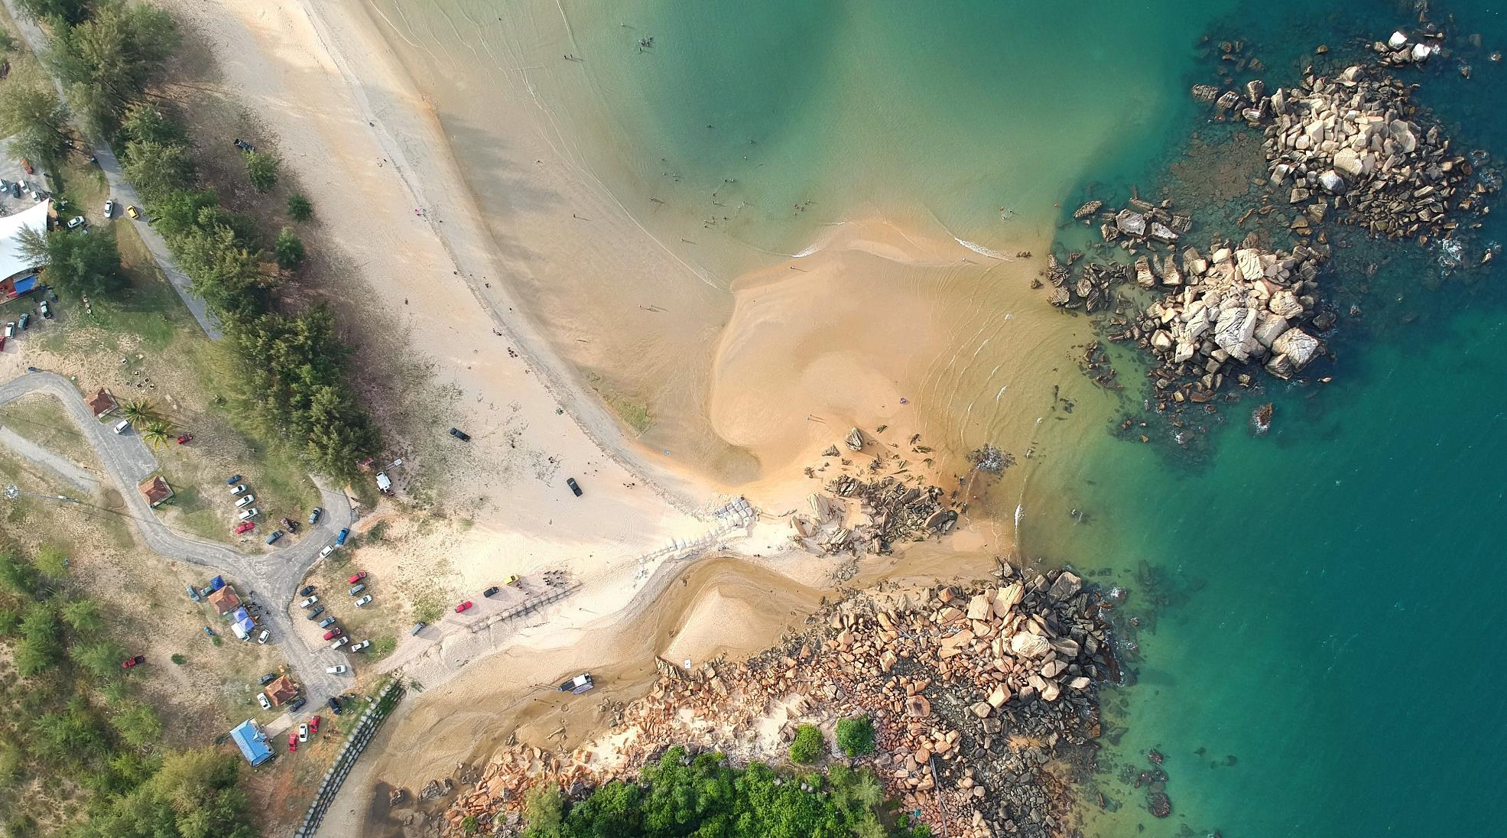


Thank you!

